Slide 1
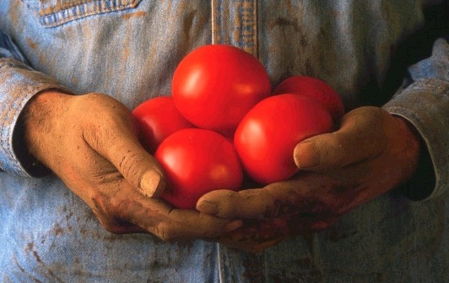
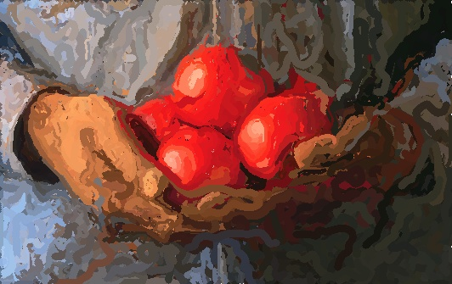
Parallelize Painterly Rendering with Multiple Stroke Size
Emily Huang
Connie Chou

Slide 2
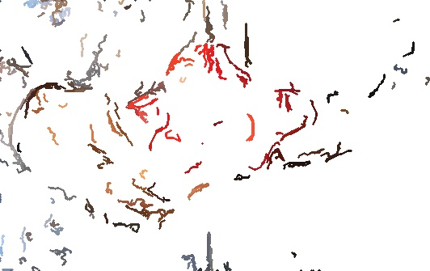
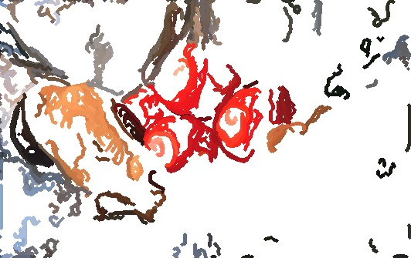

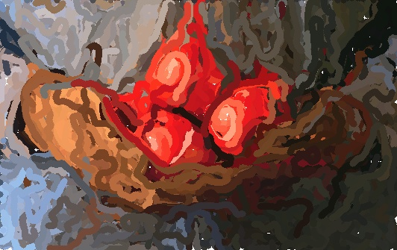




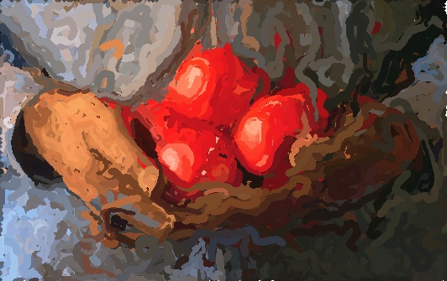
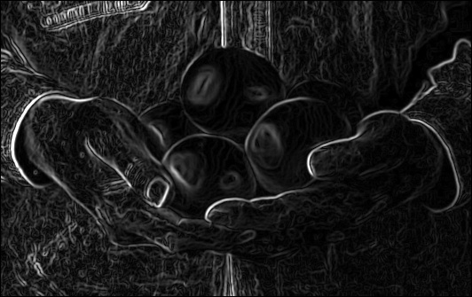
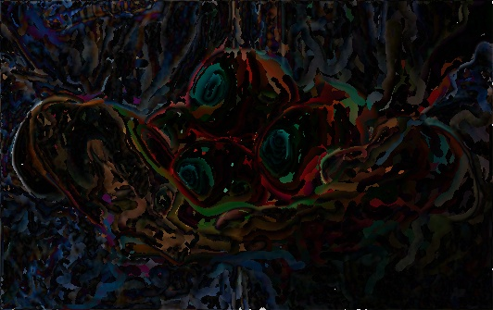

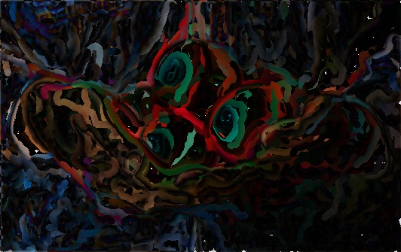

Problem Definition
R={8,4,2}
G_{fσ*Ri}
Source Image
Reference Image
Paint each stroke according to sobel gradient
Sobel Operator
Canvas
If Σpixeldiff>T, generate a stroke at the largest error point (x,y)
Grid
Final Result
Difference
Ri=2
Ri=4
Ri=8
Notes:
5*5 gaussian kernel with standard deviation fsigma*Ri
greatest difference -> the place need to add stroke
Our goal is to parallelize this algorithm using OpenMP.

Slide 3
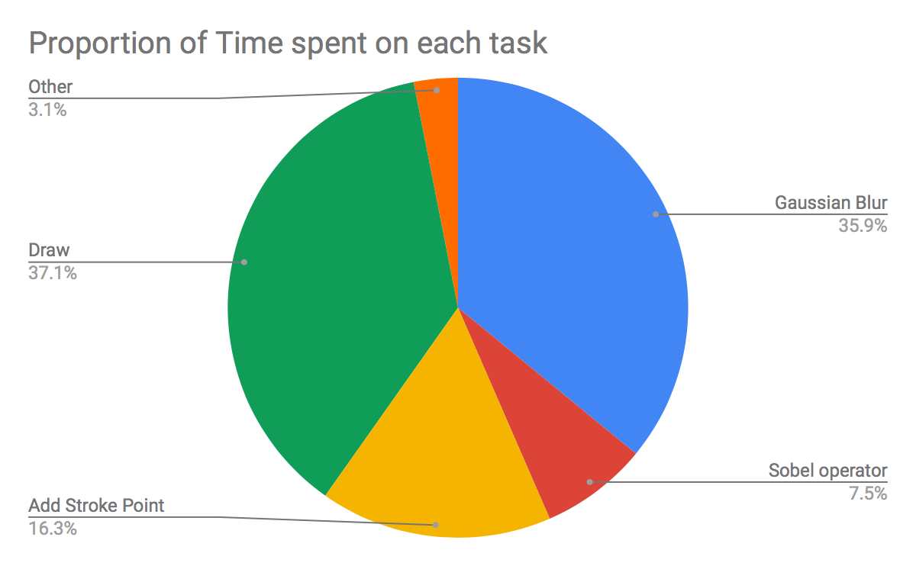
Implementation & Analysis
Env: crunchy6
Four AMD Opteron 6272 (2.1 GHz) (64 cores)
256 GB CentOS 7
Time measure tool:
std::chrono::high_resolution_clock
time command
Image:
2048x1080
1025x540
412x270
Notes:
we focus to parallelize the draw and gaussian blur

Slide 4
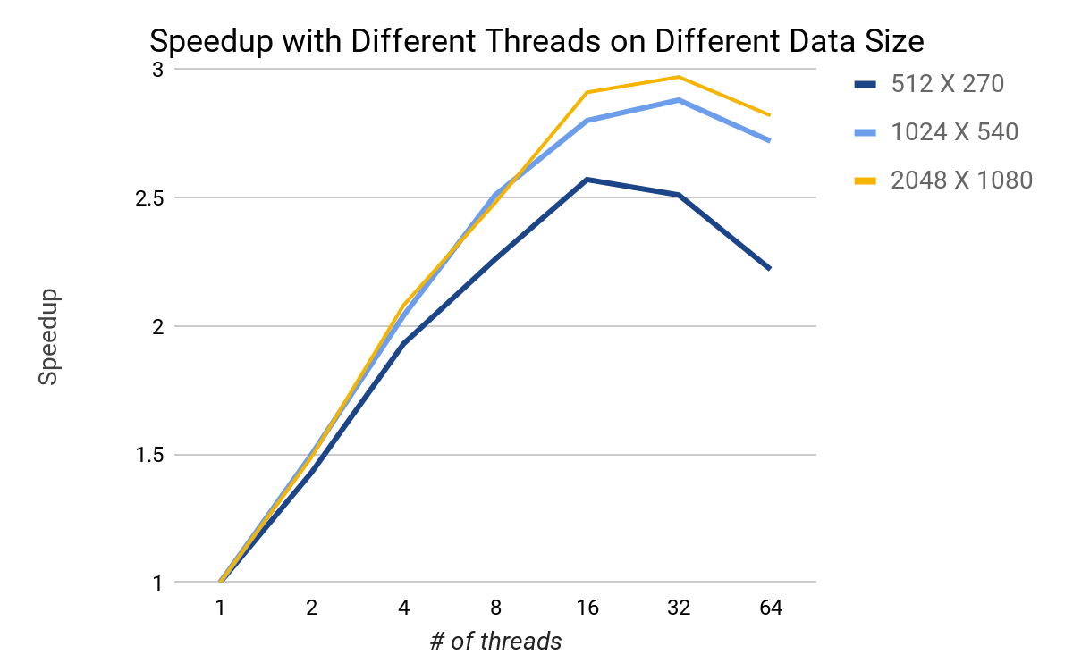
Result
Notes:
Speedup is more significant on large data size especially when thread number is large Because when data size is not big enough, it can not overcome the overhead of thread creation and management.
we keep the efficiency fixed by increasing the problem size at the same rate as we increase the number of processes/threads, the problem is weakly scalable.

Slide 5
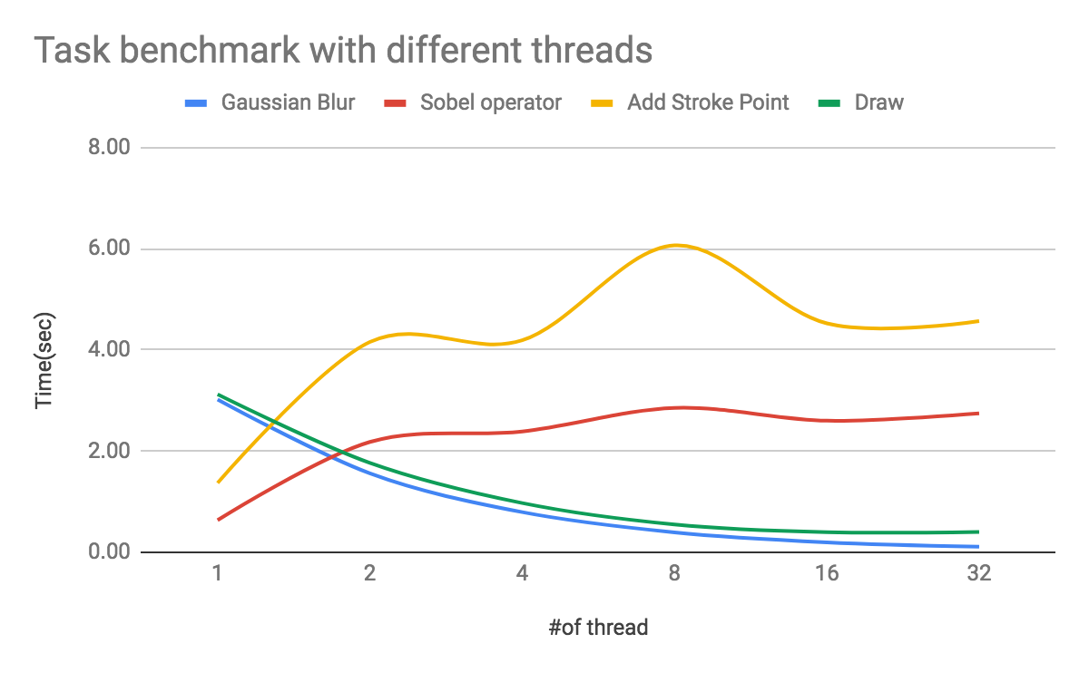
Discussion & Conclusion
No need to parallelize:
Sobel operator, Add stroke point

Slide 6
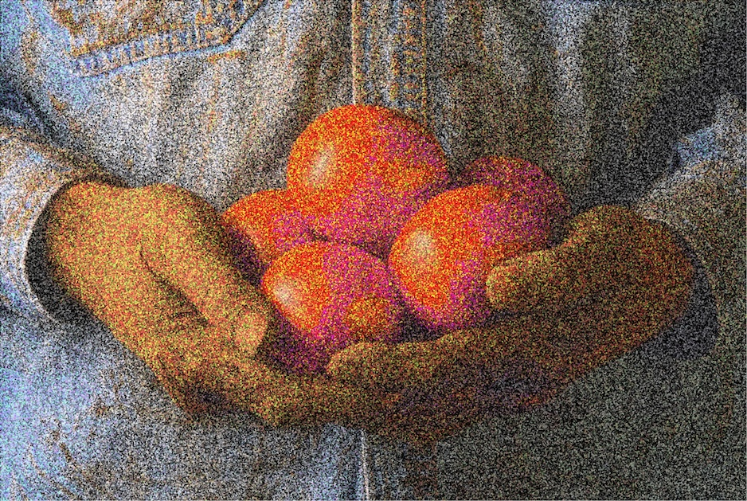
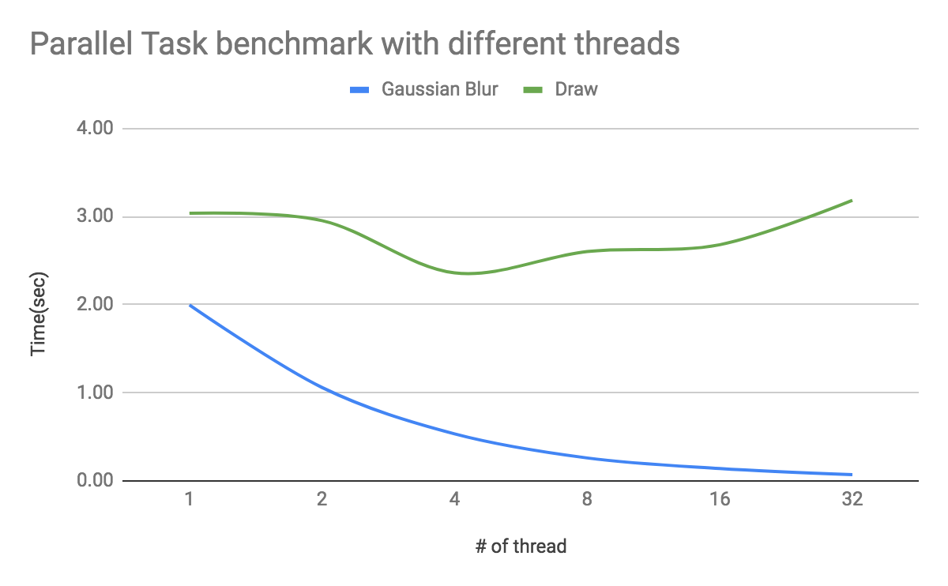
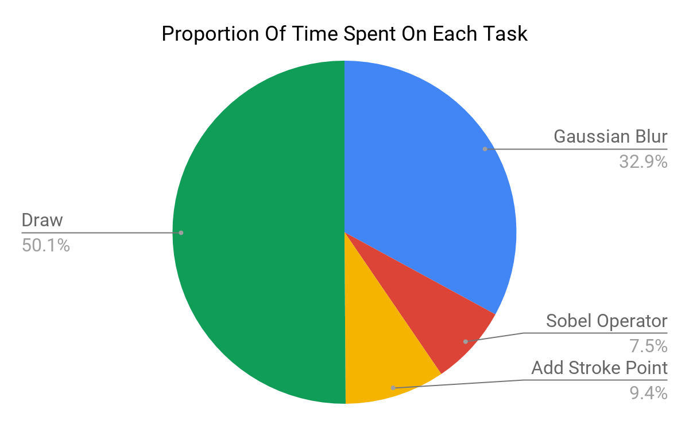
Supplement - Pointillist
Notes:
If task is small, we cannot gain benefit from parallelization, like the draw in Pointillist.

